Slide 1


Assessment Portal
Project Owners
Animesh Dhengre & Anuj Pandey
Presented By
Kaki Jaya Madhuri
2023 NucleusTeq. All Rights Reserved | Confidential and Proprietary
2020 NucleusTeq. All Rights Reserves | Confidential and Proprietary

Slide 2

Agenda
Project Overview
Use Case Diagram
Sequence Diagram
ER Diagram
Project Screenshots
2023 NucleusTeq. All Rights Reserved | Confidential and Proprietary

Slide 3
Project Overview
Assessment Portal is a web-based platform which is designed to help nucleusteq members to test their proficiency in various programming languages and keeps track on user results.
There are two types of users - Admin and Student.
Each question in the quiz is of multiple choice. After successful submission of quiz, obtained marks are stored in the database.
Students can view their individual results and admin can view all the students results.
2023 NucleusTeq. All Rights Reserved | Confidential and Proprietary

Slide 4
Project Overview
Software Used :
Backend - Spring Boot
Frontend - ReactJs
Database - PostgreSql
Deployment : GitHub
Testing : Postman
2023 NucleusTeq. All Rights Reserved | Confidential and Proprietary

Slide 5
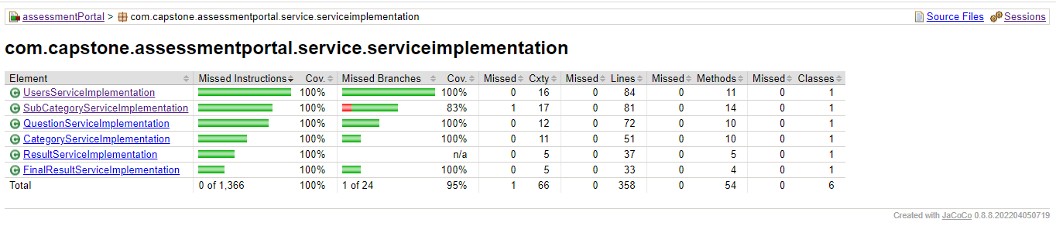
Project Overview
Jacoco Report For Junit Coverage
2023 NucleusTeq. All Rights Reserved | Confidential and Proprietary

Slide 6
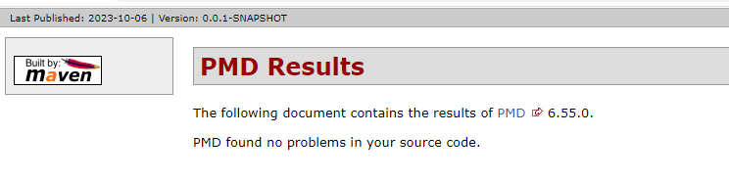
Project Overview
PMD Report
2023 NucleusTeq. All Rights Reserved | Confidential and Proprietary

Slide 7
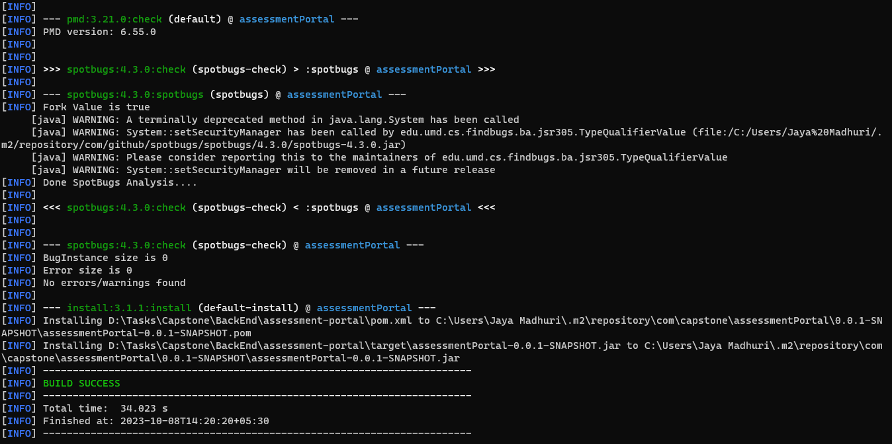
Project Overview
Build Success Report
2023 NucleusTeq. All Rights Reserved | Confidential and Proprietary

Slide 8
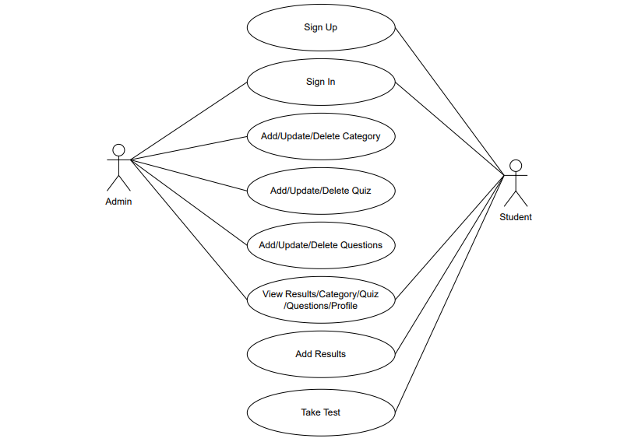
Use Case Diagram
2023 NucleusTeq. All Rights Reserved | Confidential and Proprietary

Slide 9
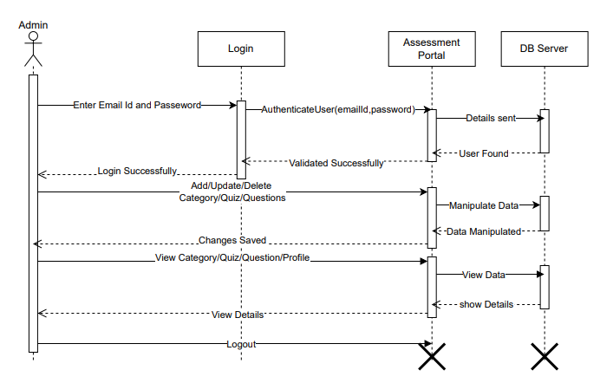
Sequence Diagram
Admin :
2023 NucleusTeq. All Rights Reserved | Confidential and Proprietary

Slide 10
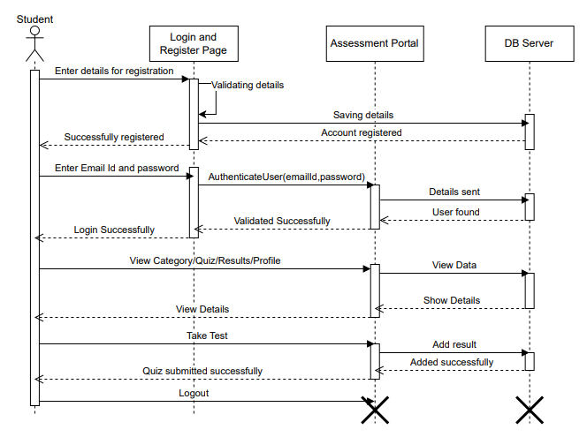
Sequence Diagram
Student :
2023 NucleusTeq. All Rights Reserved | Confidential and Proprietary

Slide 11
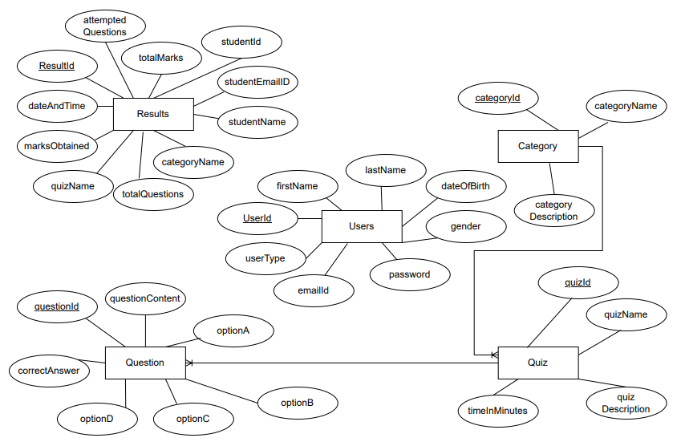
ER Diagram
2023 NucleusTeq. All Rights Reserved | Confidential and Proprietary

Slide 12
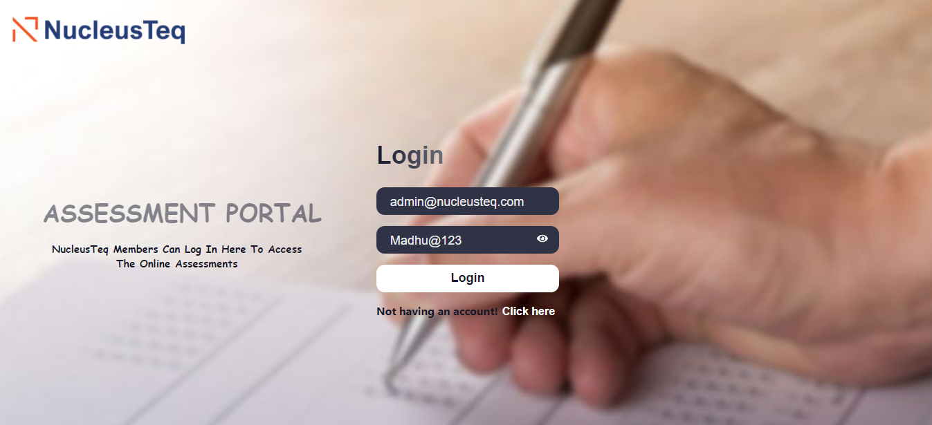
Project Screenshots
Login Page :
2023 NucleusTeq. All Rights Reserved | Confidential and Proprietary

Slide 13
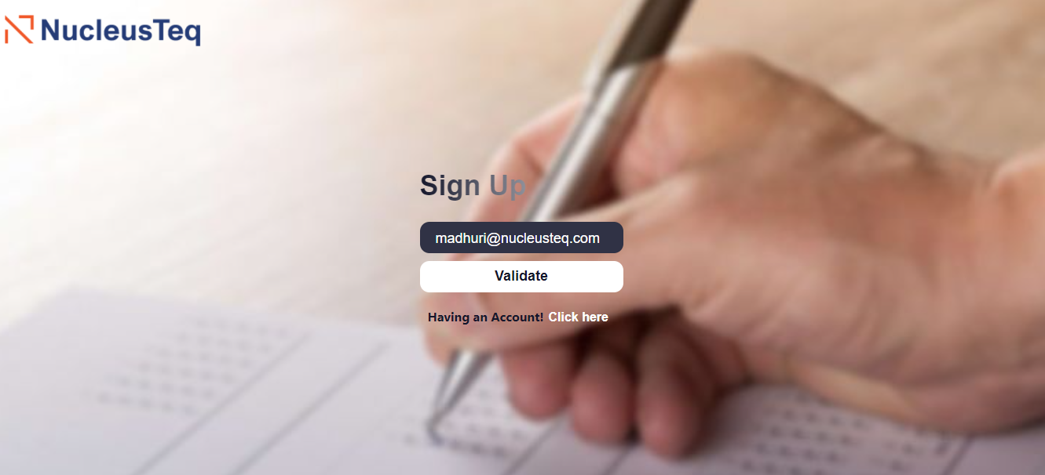
Project Screenshots
Register Page :
2023 NucleusTeq. All Rights Reserved | Confidential and Proprietary

Slide 14
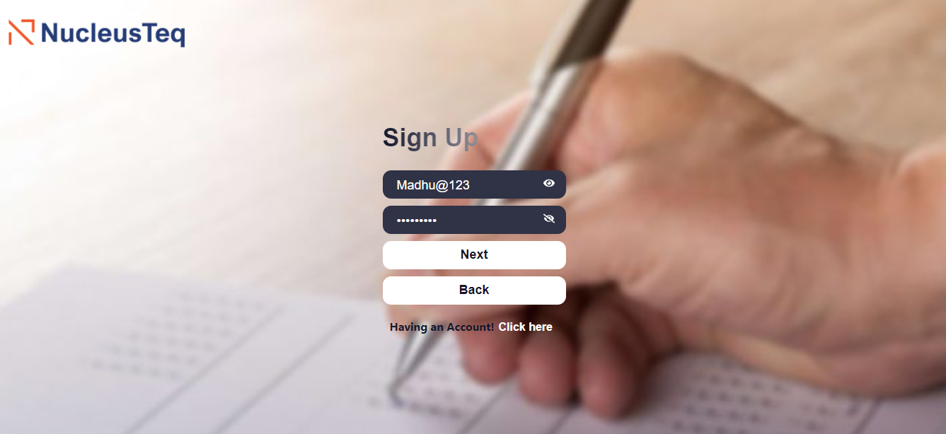
Project Screenshots
Register Page :
2023 NucleusTeq. All Rights Reserved | Confidential and Proprietary

Slide 15
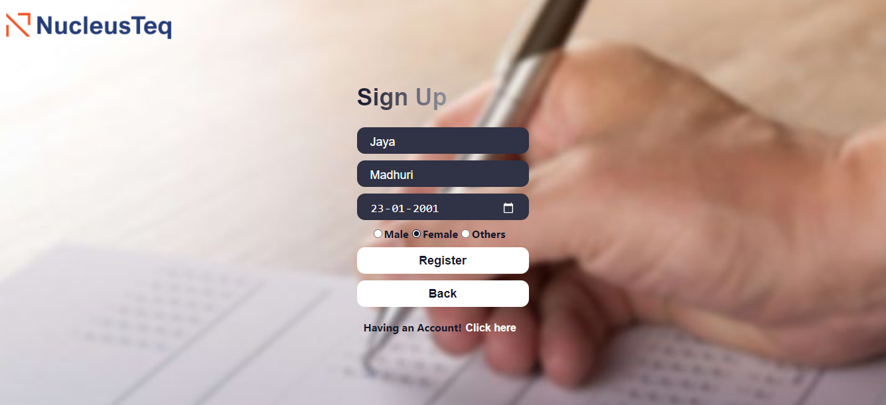
Project Screenshots
Register Page :
2023 NucleusTeq. All Rights Reserved | Confidential and Proprietary

Slide 16
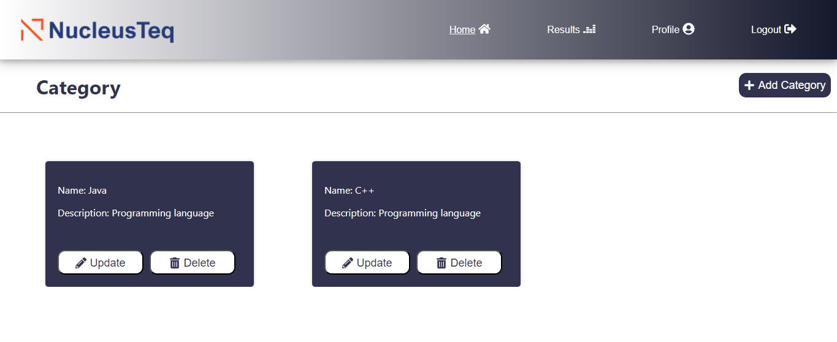
Project Screenshots
Admin Home Page :
2023 NucleusTeq. All Rights Reserved | Confidential and Proprietary

Slide 17
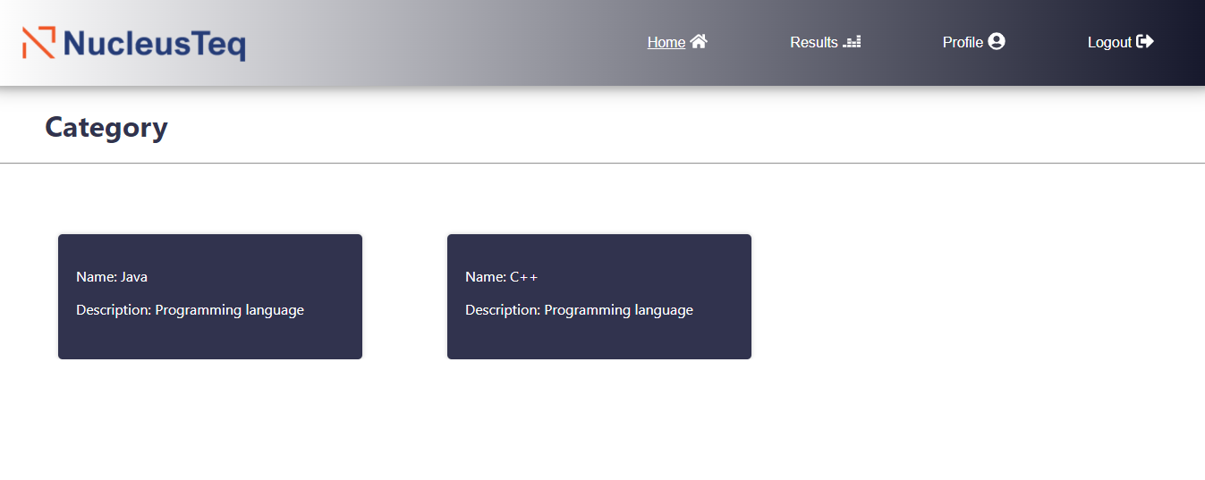
Project Screenshots
Student Home Page :
2023 NucleusTeq. All Rights Reserved | Confidential and Proprietary

Slide 18
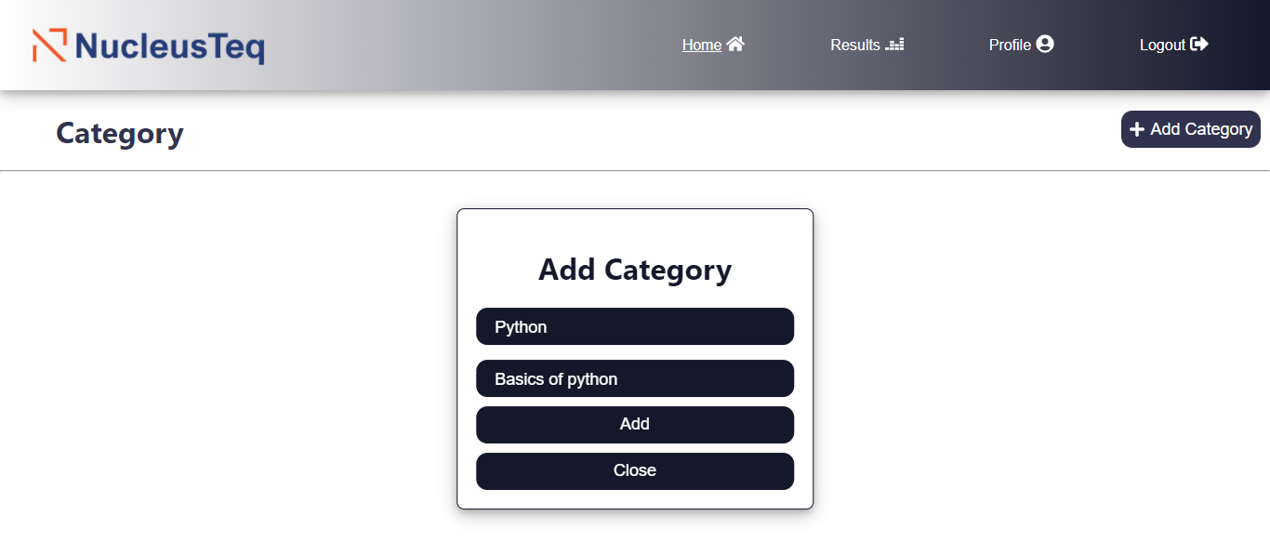
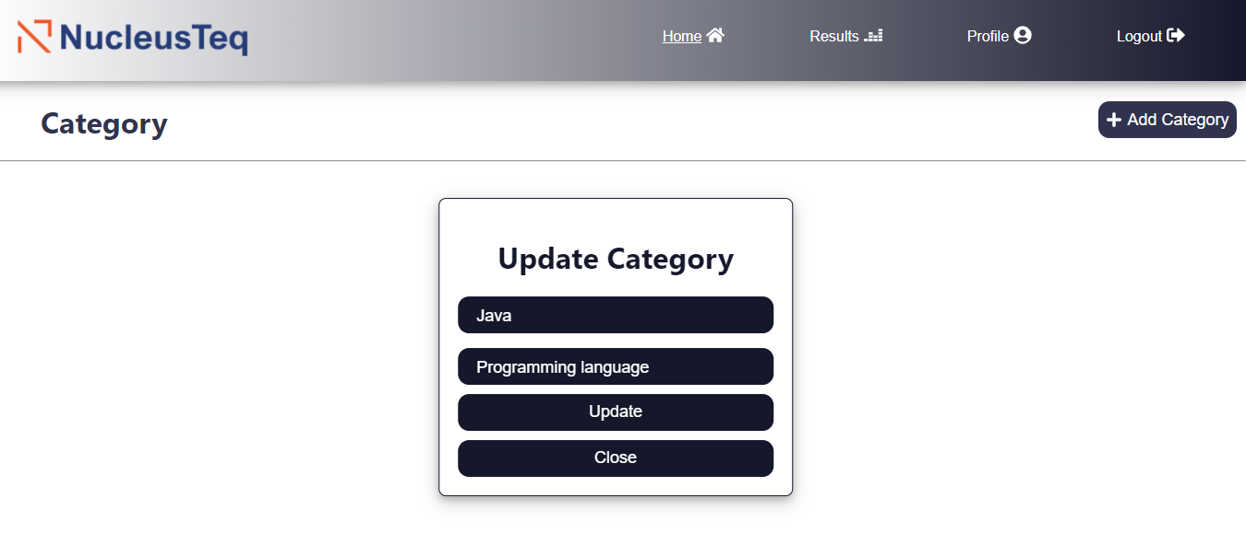
Project Screenshots
Add/Update Category Page:
2023 NucleusTeq. All Rights Reserved | Confidential and Proprietary

Slide 19
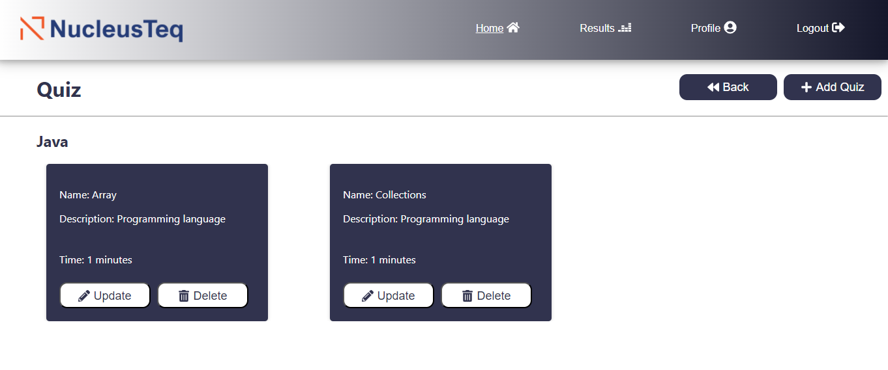
Project Screenshots
Quiz Page :
2023 NucleusTeq. All Rights Reserved | Confidential and Proprietary

Slide 20
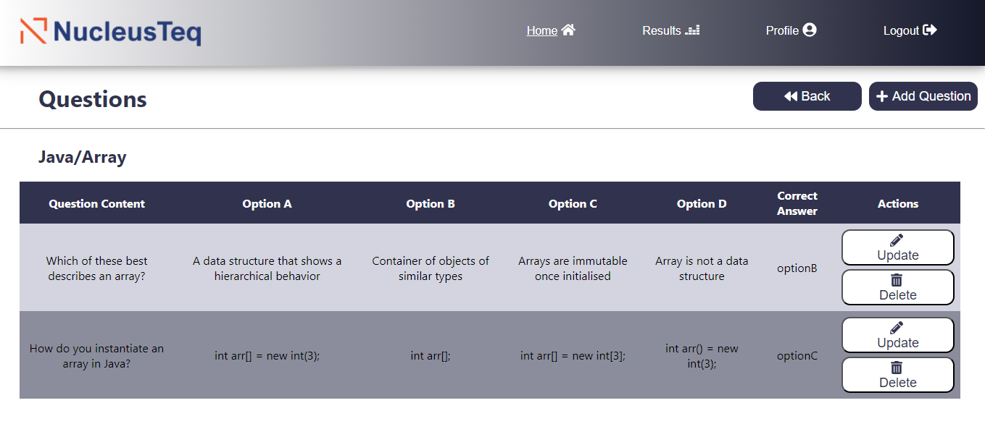
Project Screenshots
Questions Page :
2023 NucleusTeq. All Rights Reserved | Confidential and Proprietary

Slide 21
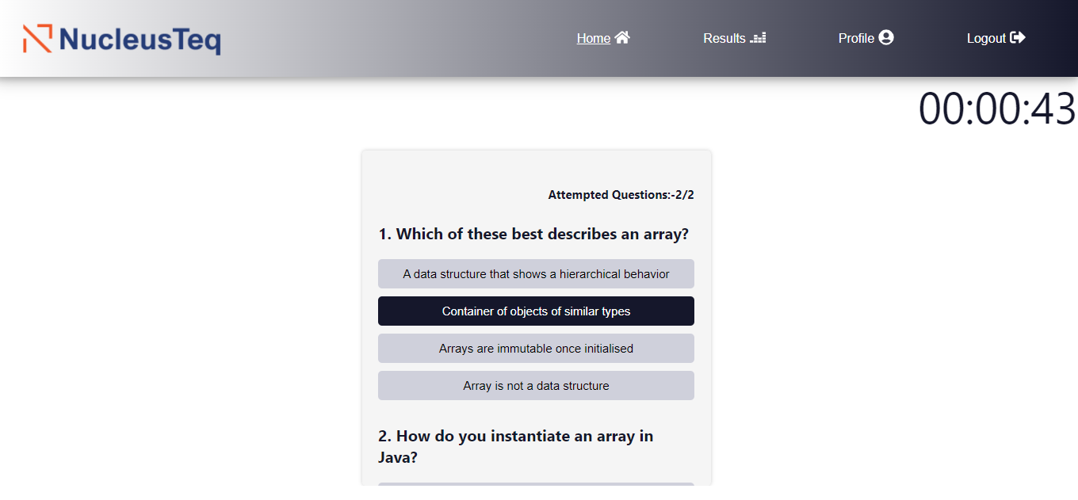
Project Screenshots
Test Page :
2023 NucleusTeq. All Rights Reserved | Confidential and Proprietary

Slide 22
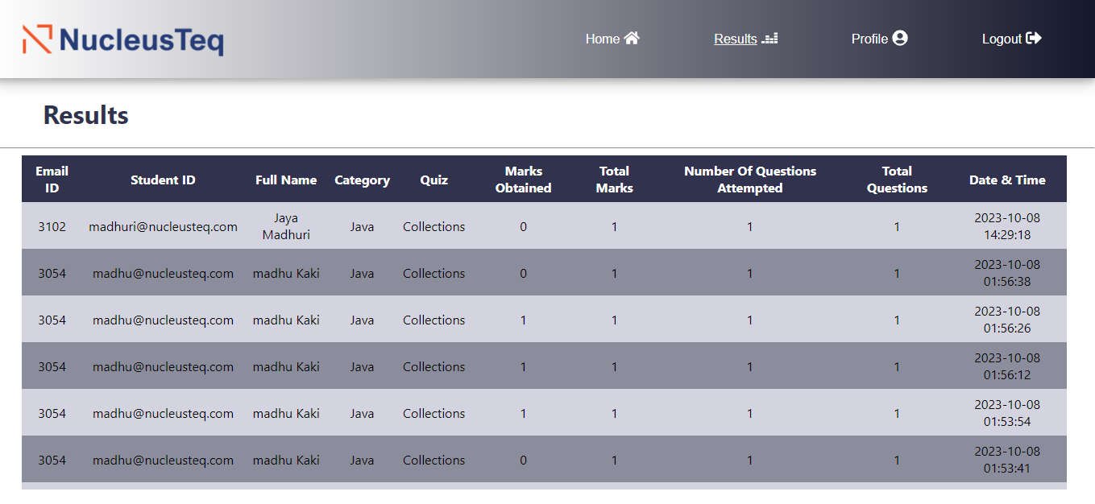
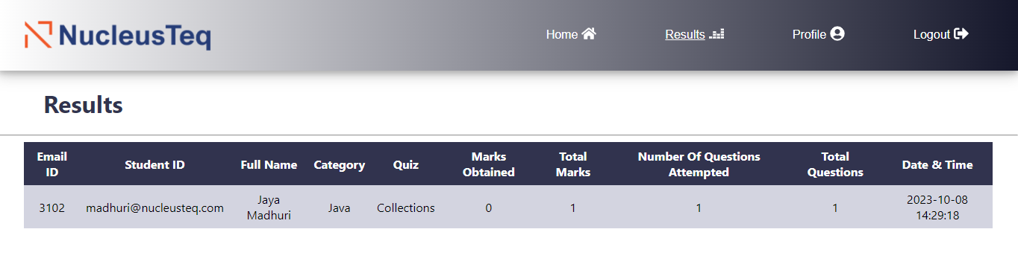
Project Screenshots
Admin Results Page :
Student Results Page :
2023 NucleusTeq. All Rights Reserved | Confidential and Proprietary

Slide 23
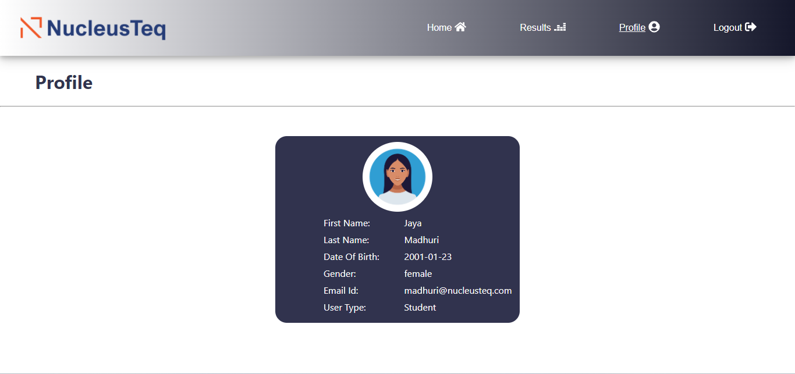
Project Screenshots
Profile Page :
2023 NucleusTeq. All Rights Reserved | Confidential and Proprietary

Slide 24
Thank You
2023 NucleusTeq. All Rights Reserved | Confidential and Proprietary

